Slide 1













Evolving Landscapes of Television:
An Analytical Dive into TV Show Trends on Netflix
Images - Netflix

Slide 2






Who’s presenting?
Ammarah
Eoghan
Nana
Nida
Safa
MANAGE PROFILES

Slide 3

Source
Notes:
The show remains Netflix’s biggest-ever hit: in the first month after its release subscribers spent around 1.65bn hours watching it, equivalent to 190,000 years.

Slide 4

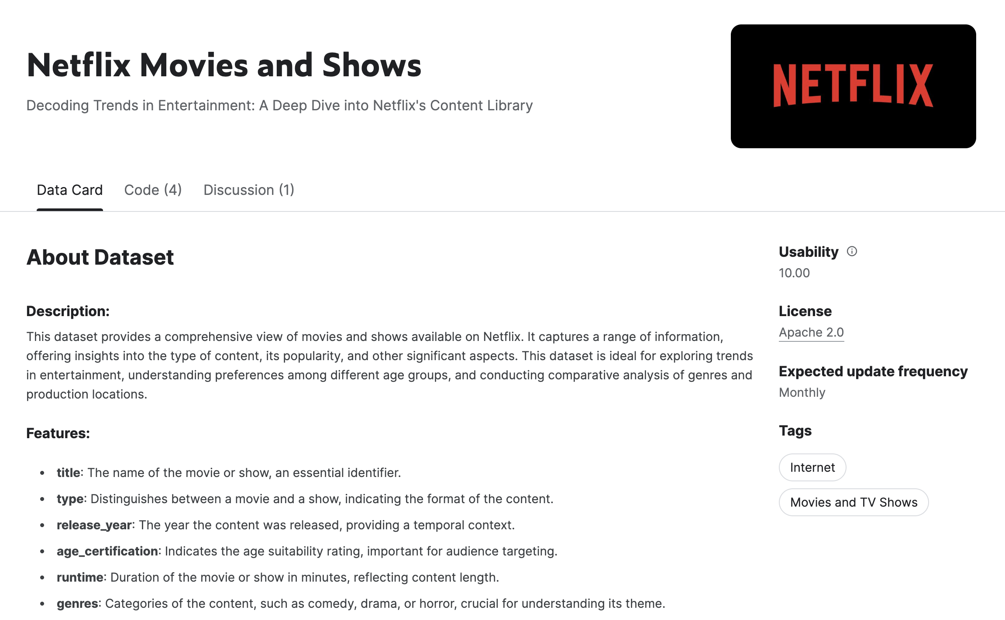
The Dataset

Slide 5
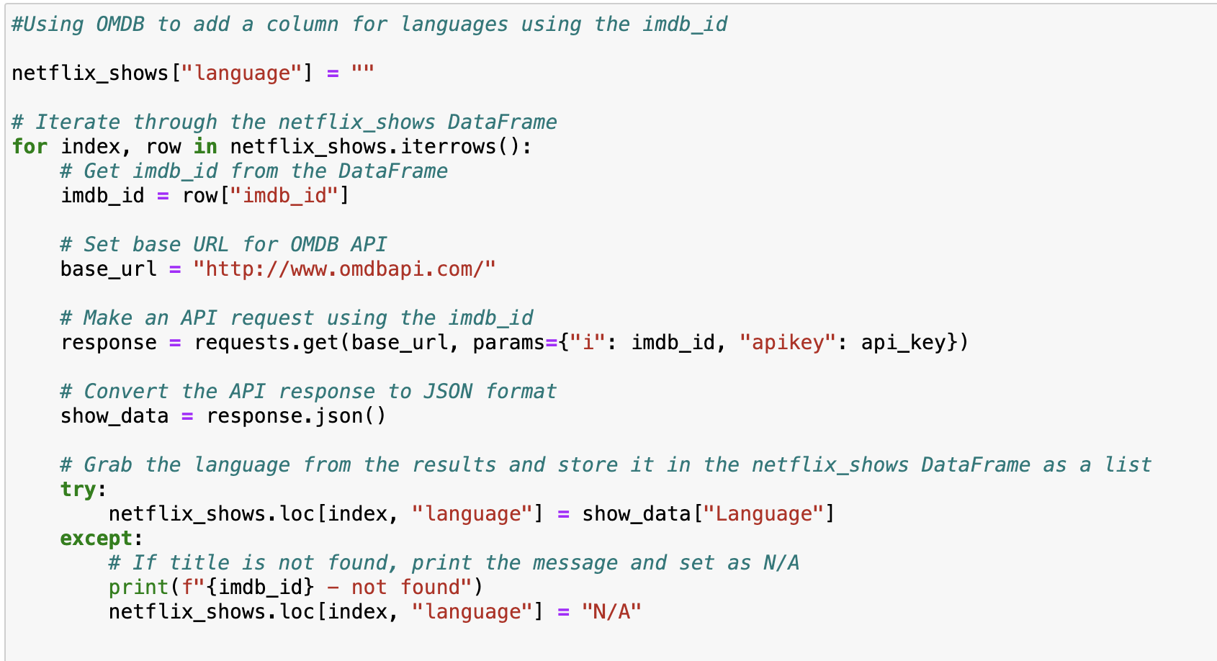
OMDB API to supplement the primary dataset

Slide 6
Research Questions
1
How has Netflix’s content strategy for TV shows evolved?
2
What are the factors that determine a show’s success/popularity?
3
Has there been a shift in target audience demographics?
4
Did the pandemic change tastes in favour of reality TV?

Slide 7
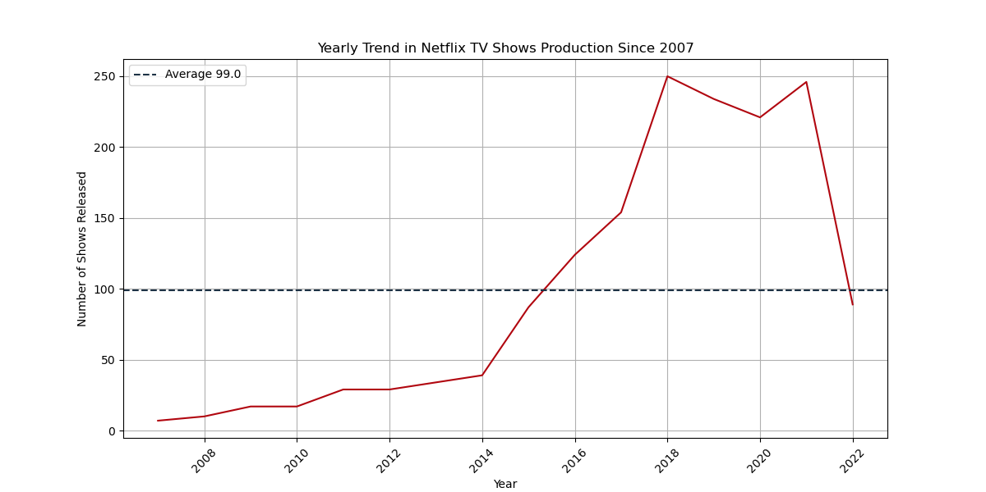

1
How has Netflix’s content strategy for TV shows evolved?

Slide 8
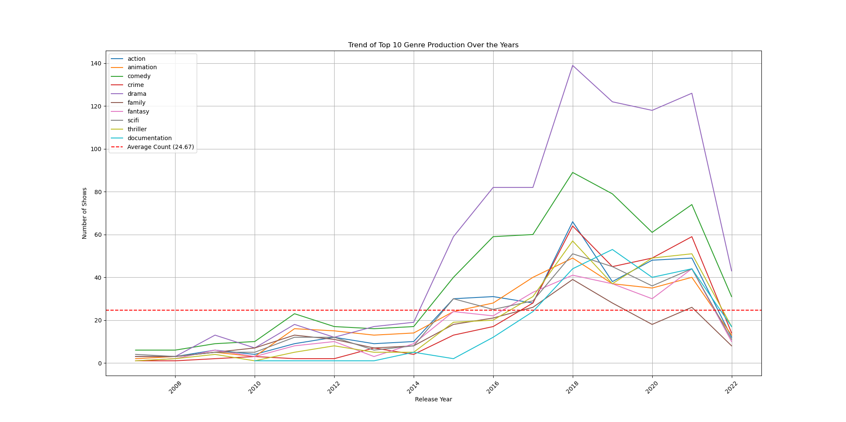
1
How has Netflix’s content strategy for TV shows evolved?

Slide 9
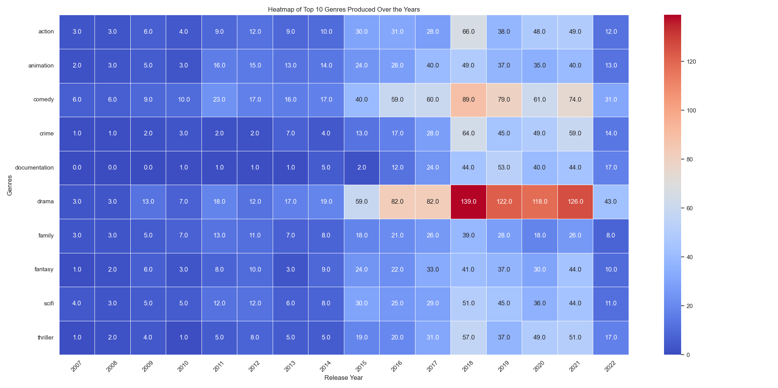
1
How has Netflix’s content strategy for TV shows evolved?

Slide 10
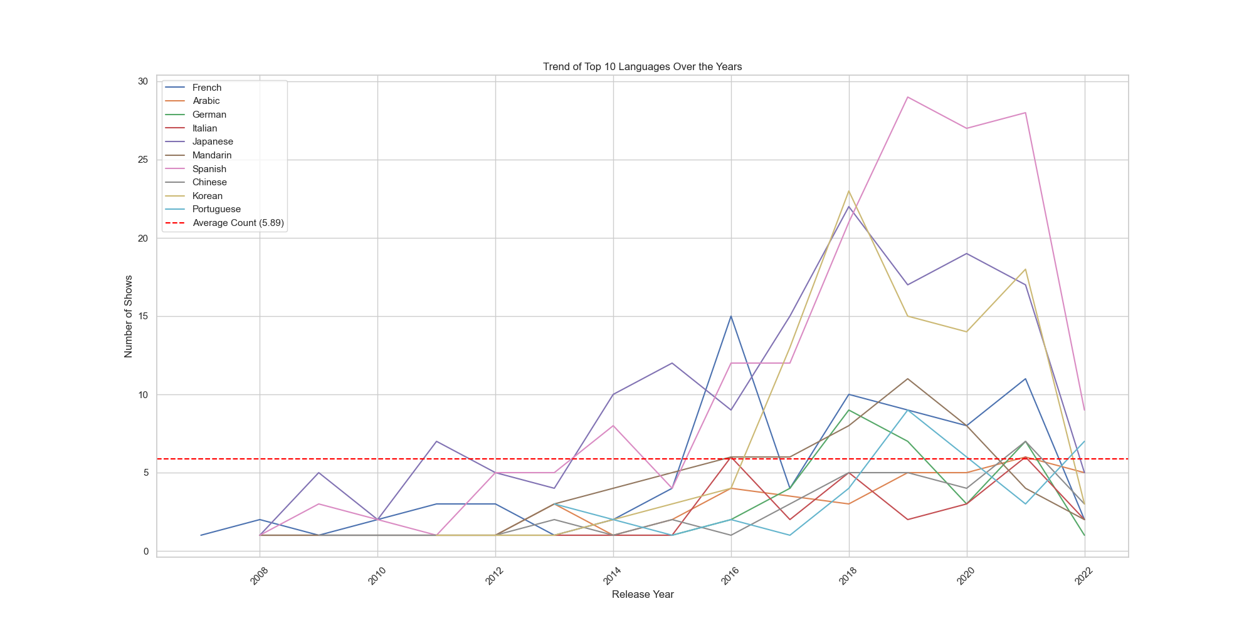
1
How has Netflix’s content strategy for TV shows evolved?

Slide 11
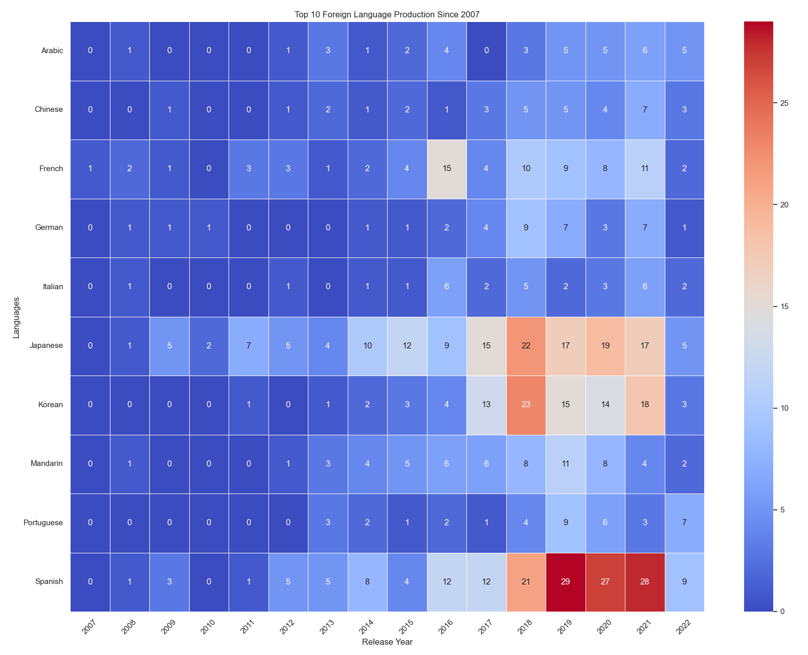
1
How has Netflix’s content strategy for TV shows evolved?

Slide 12
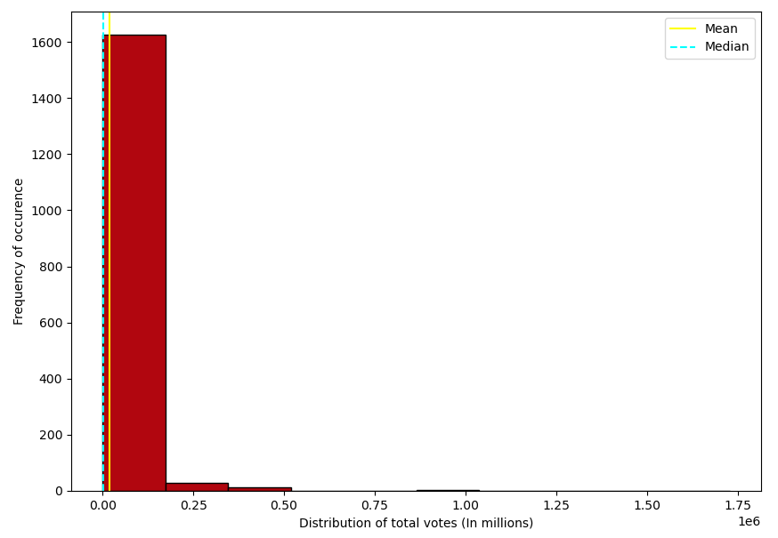
2
What are the factors that determine a show’s success/popularity?

Slide 13
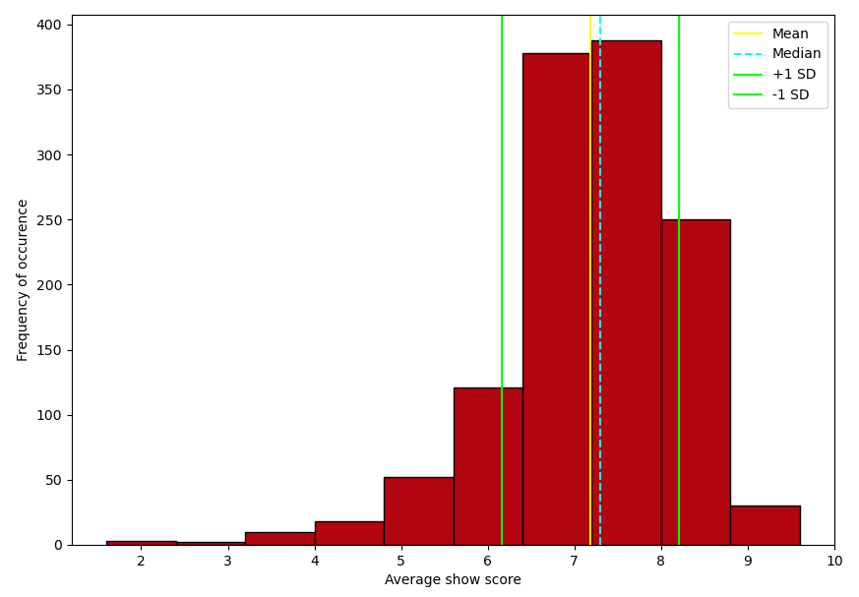
2
What are the factors that determine a show’s success/popularity?

Slide 14
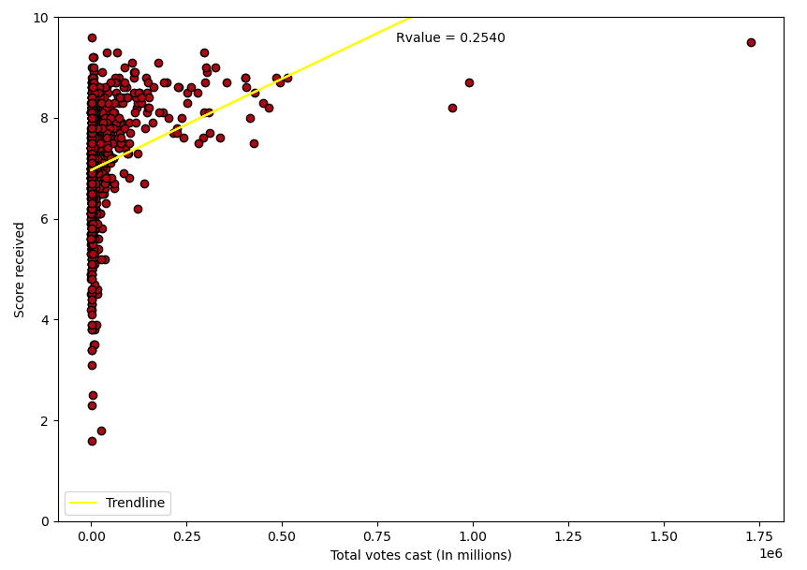
2
What are the factors that determine a show’s success/popularity?

Slide 15
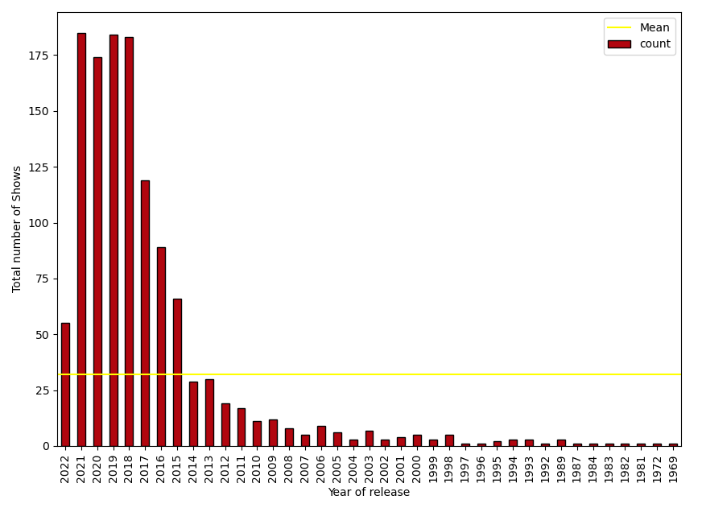
2
What are the factors that determine a show’s success/popularity?

Slide 16
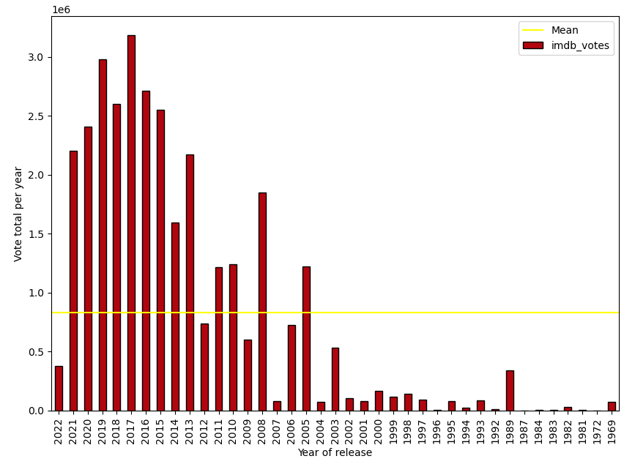
2
What are the factors that determine a show’s success/popularity?

Slide 17
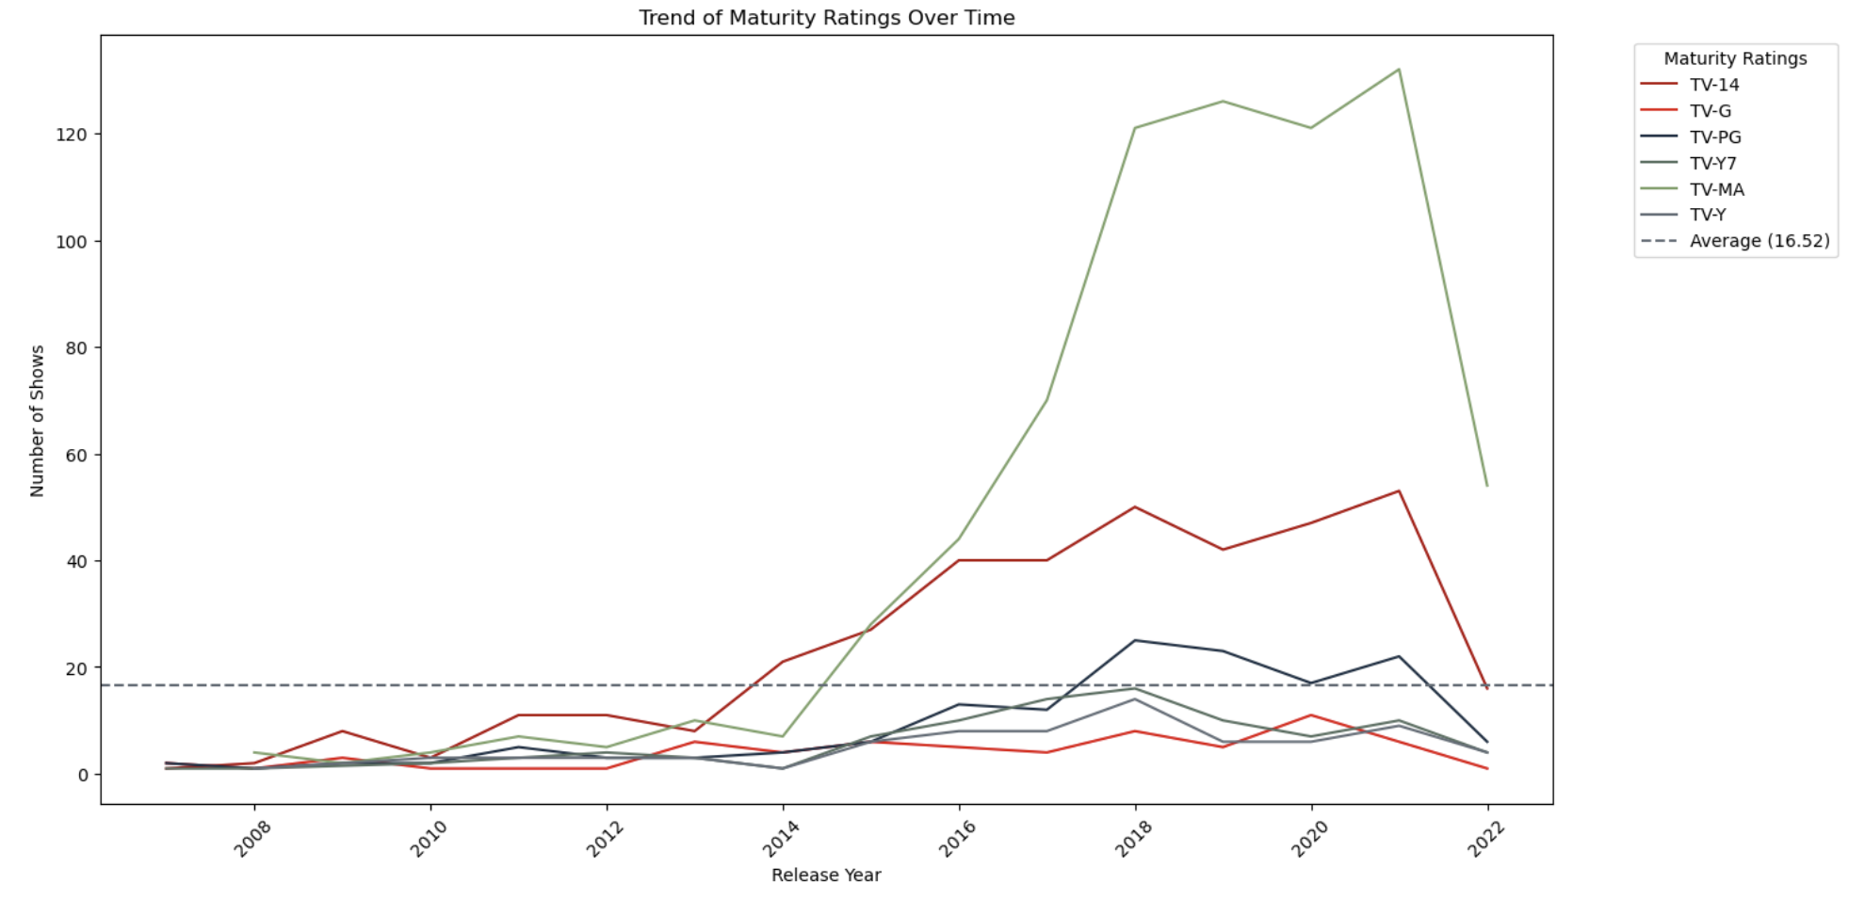
3
Has there been a shift in target audience demographics?

Slide 18
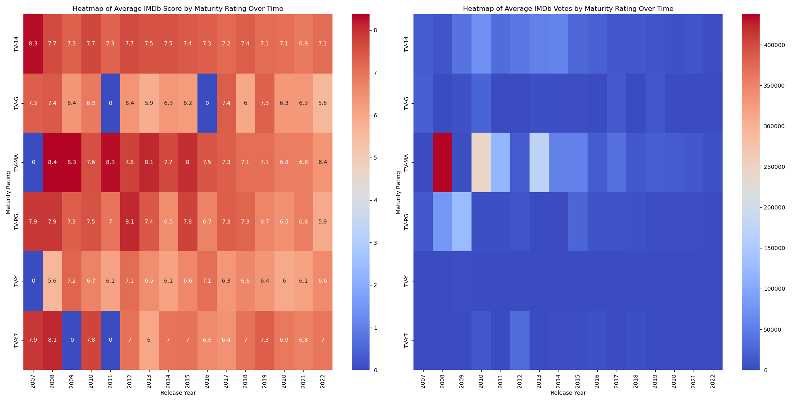
3
Has there been a shift in target audience demographics?

Slide 19
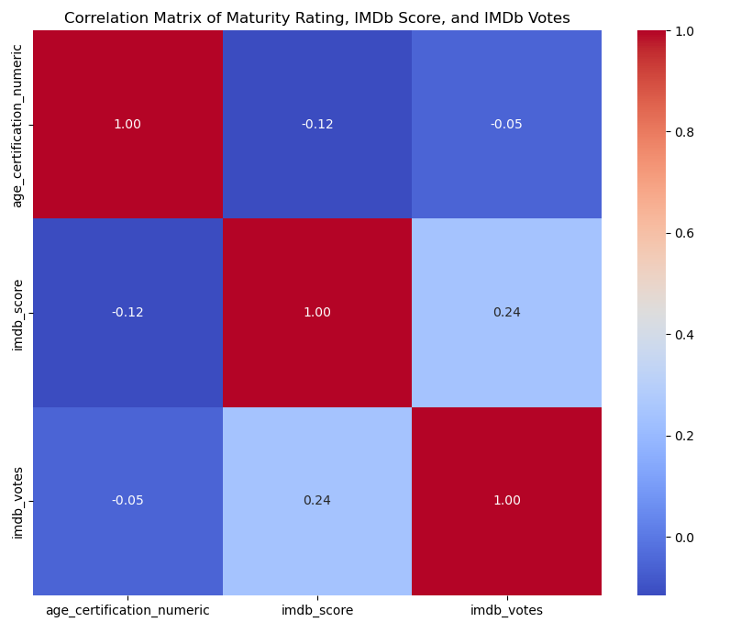
3
Has there been a shift in target audience demographics?

Slide 20
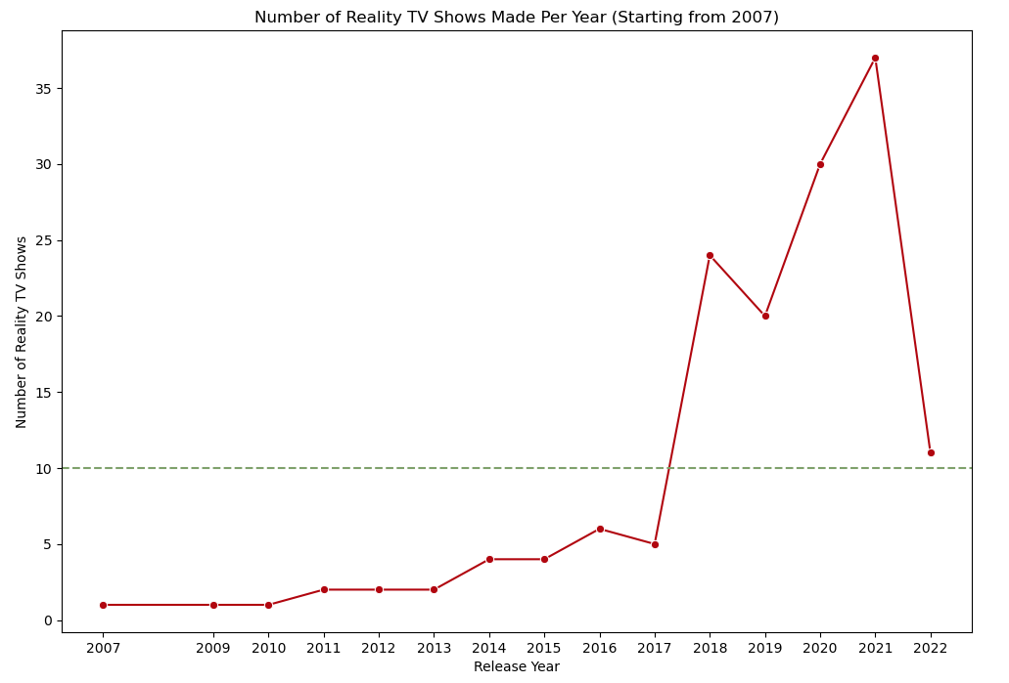
4
Did the pandemic change tastes in favour of reality TV?

Slide 21
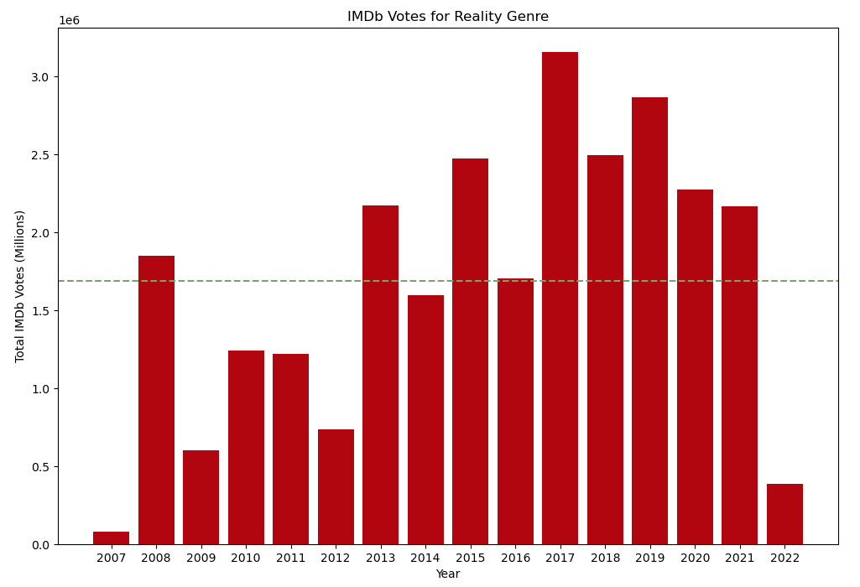
4
Did the pandemic change tastes in favour of reality TV?

Slide 22
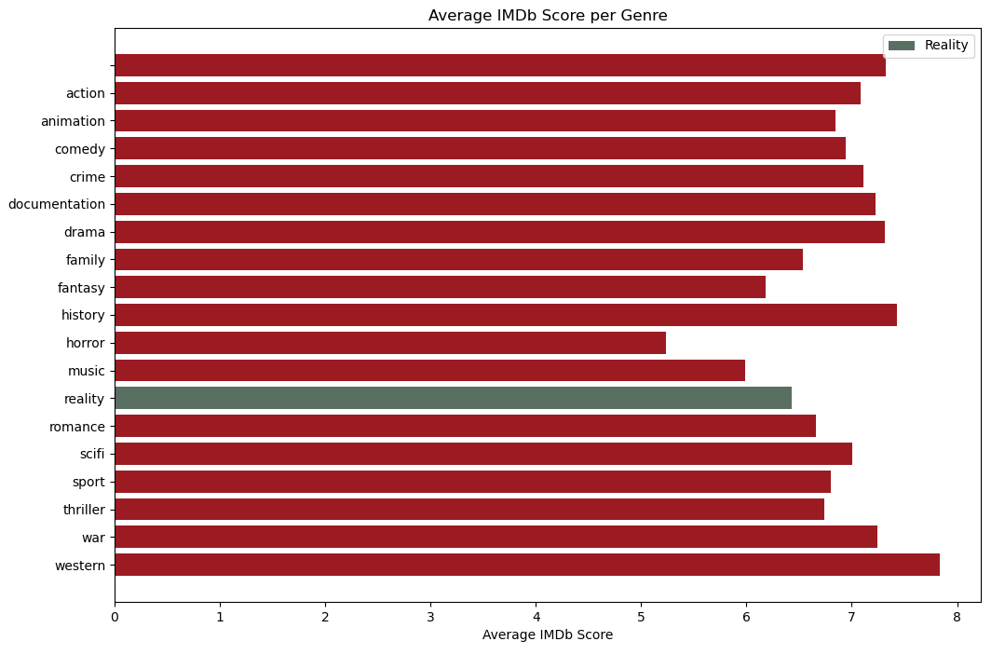
4
Did the pandemic change tastes in favour of reality TV?

Slide 23


